Slide 1
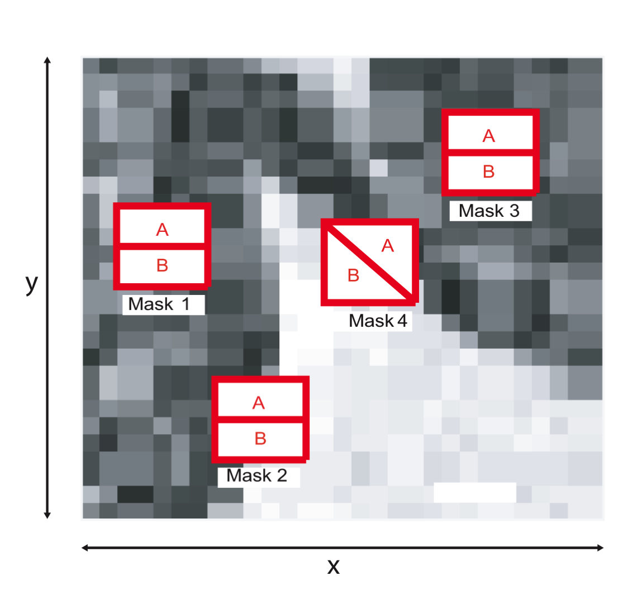
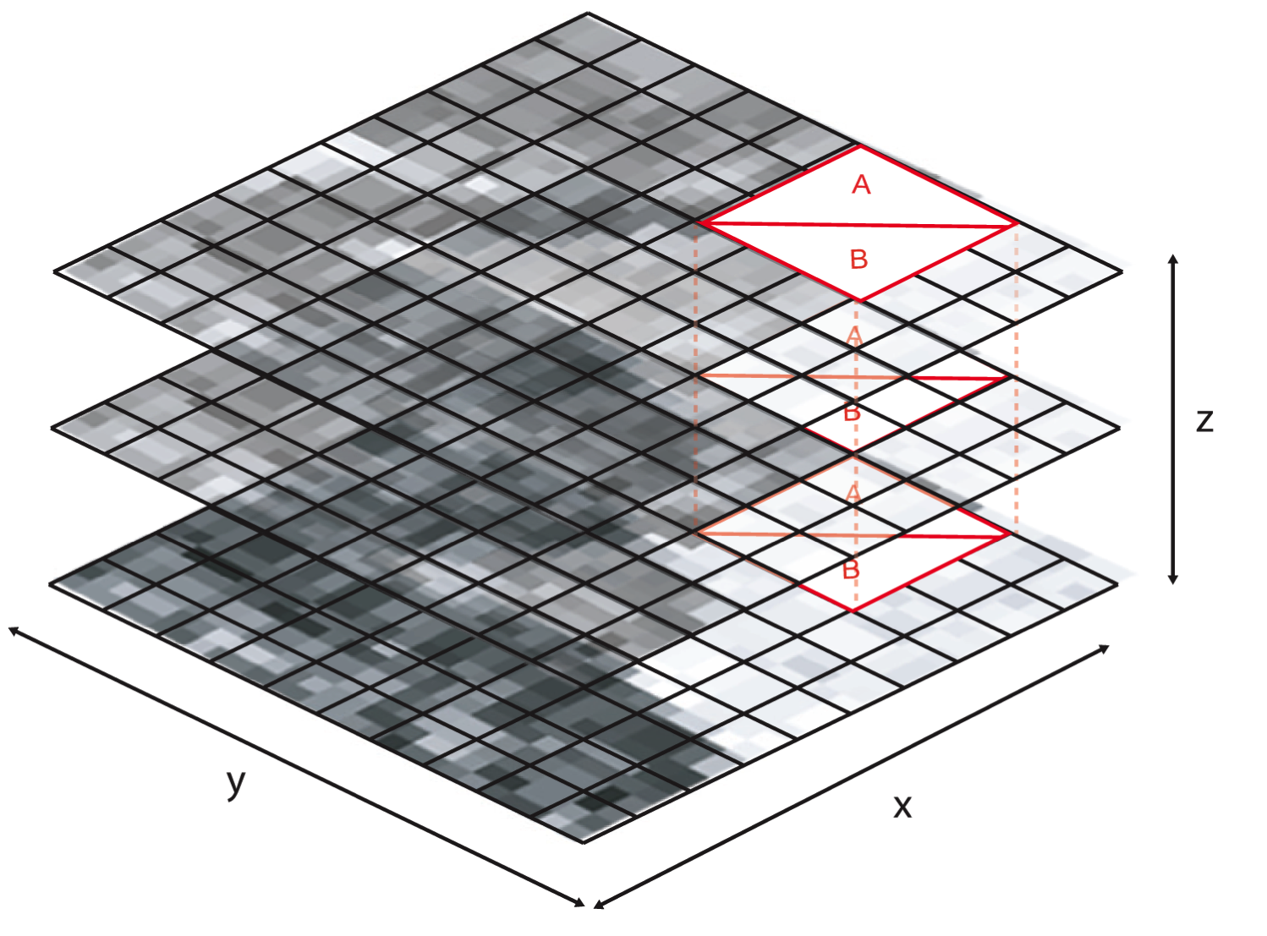
Statistical Surface Detection MRI Tissue Segmentation
DMT Lab have developed a new method for MRI/CT surface segmentation
This method uses a dual region 3D neighbourhood mask to compute a measure of similarity between MRI/CT tissue regions. (image below: low output for masks1,2 and 3. High output for mask 4).
By applying surface detection using the 3D data we can resolve accurate surface information in the X,Y and Z dimensions.
Performance of this method improves over all current surface segmentation in providing accurate closed surfaces in complex texture (tissue) and noisy images.
We are currently applying this methods for tumour segmentation using the BRATS 2015 dataset.

Slide 2
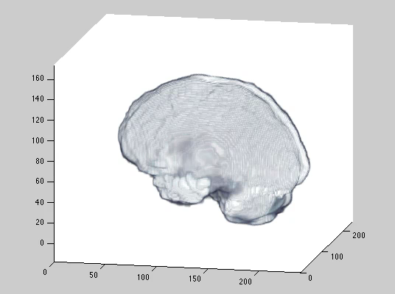
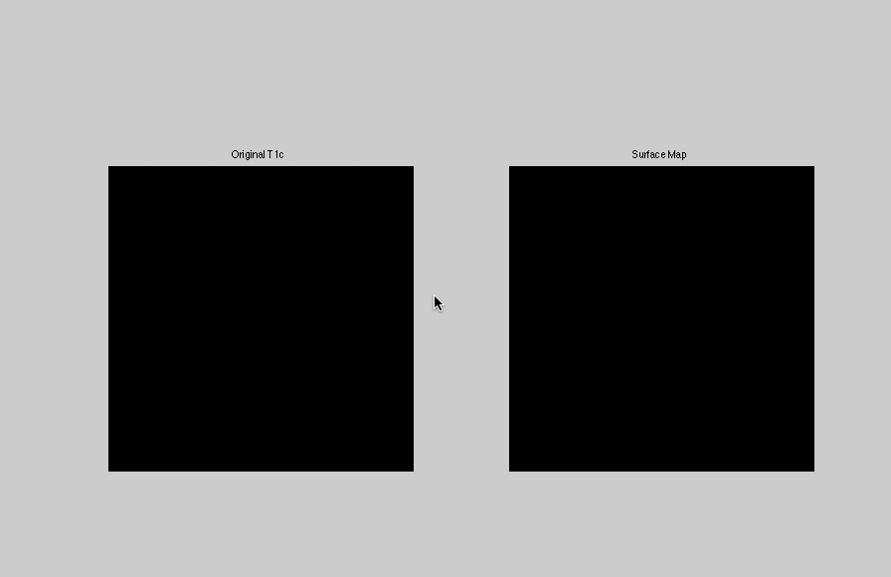
Statistical Surface Detection MRI Tissue Segmentation
Part 1.
Boundary segmentation of Brain.
Part 2.
Internal surface structure segmentation
Slice by slice comparison of image and surface map output.
Smith, S.; Williams, I., "A Statistical Method for Improved 3D Surface Detection," in Signal Processing Letters, IEEE , vol.22, no.8, pp.1045-1049, Aug. 2015
Email: Samuel.smith@mail.bcu.ac.uk
Ian.williams@bcu.ac.uk

